Slide 1
Learning Objective
I will be able to define the domain and range of various relations
Success Criteria
At the end of the lesson, I will be able to:
define the domain and range of various relations.

Slide 2
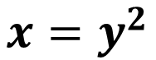
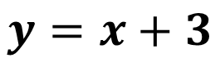
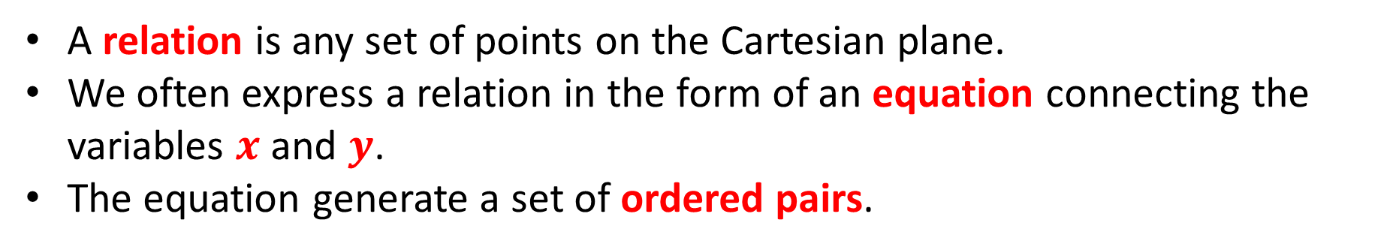
Concept Development
A relation is any set of points on the Cartesian plane.
We often express a relation in the form of an equation connecting the variables $x$ and $y$.
The equation generate a set of ordered pairs.
$$y=x+3$$
$$x=y^{2}$$

Slide 3

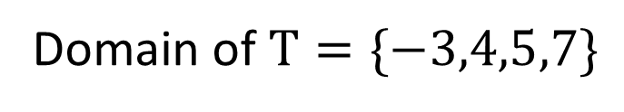
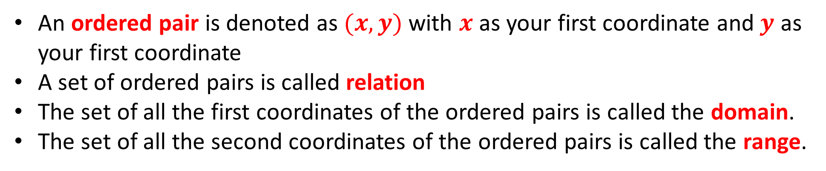


Concept Development
An ordered pair is denoted as $(x,y)$ with $x$ as your first coordinate and$y$ as your first coordinate
A set of ordered pairs is called relation
The set of all the first coordinates of the ordered pairs is called the domain.
The set of all the second coordinates of the ordered pairs is called the range.
$$S=\{\left(1,1\right),\left(1,2\right),\left(3,4\right),\left(5,6\right)\}$$
$$T=\{\left(−3,5\right),\left(4,12\right),\left(5,12\right),\left(7,−6\right)\}$$
Domain of $S=\{1,3,5\}$
Range of $S=\{1,2,4,6\}$
Domain of $T=\{−3,4,5,7\}$
Range of $T=\{−6,5,12\}$

Slide 4
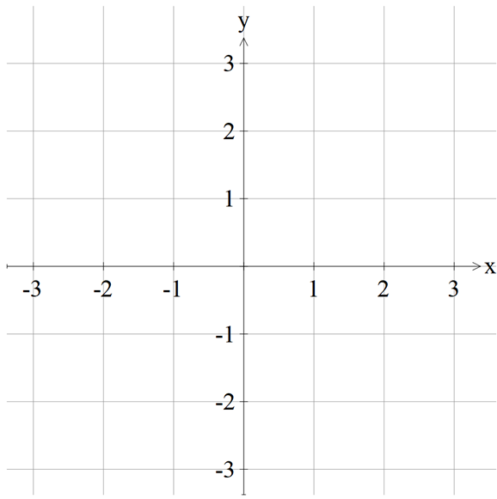


Guided Practice
Sketch a graph of each of the following relations and state its domain and range:
$$\{\left(−2,−1\right),\left(−1,−1\right),\left(−1,1\right),\left(0,1\right),\left(1,−1\right)\}$$
Domain $=\{−2,−1,0,1\}$
Range $=\{−1,1\}$

Slide 5


Guided Practice
Sketch a graph of each of the following relations and state its domain and range:
$$\{\left(x,y\right):x^{2}+y^{2}=1,x∈\left[−1,1\right]\}$$
Domain $=\left\{x:−1≤x≤1\right\}=[−1,1]$
Range $=\left\{y:−1≤y≤1\right\}=[−1,1]$

Slide 6


Guided Practice
Sketch a graph of each of the following relations and state its domain and range:
$$\{\left(x,y\right):y=2x−1,x∈\left[−1,2\right]\}$$
Domain $=\left\{x:−1≤x≤2\right\}=[−1,2]$
Range $=\left\{y:−3≤y≤3\right\}=[−3,3]$

Slide 7


Guided Practice
Sketch a graph of each of the following relations and state its domain and range:
$$\{\left(x,y\right):y=x+1,x≥0\}$$
Domain $=\left\{x:x≥0\right\}=\left[0,∞\right)$
Range $=\left\{y:y≥1\right\}=[1,∞)$

Slide 8


Guided Practice
Sketch a graph of each of the following relations and state its domain and range:
$$\{\left(x,y\right):y=−2x+1,x>1\}$$
Domain $=\left\{x:x>1\right\}=(1,∞)$
Range $=\left\{y:y<−1\right\}=(−∞,−1)$

Slide 9
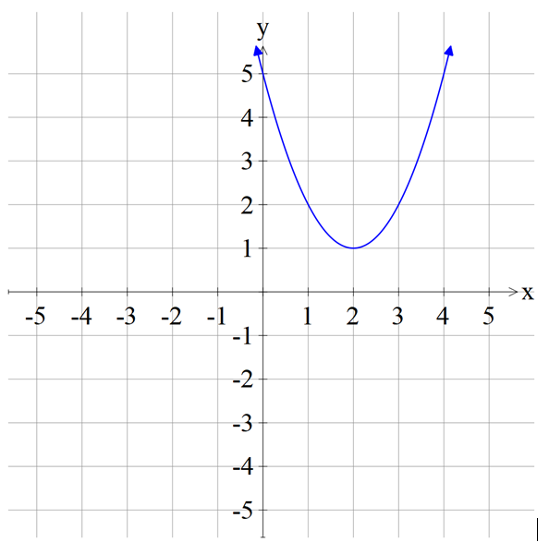

Guided Practice
Complete the square, sketch a graph and state its range. The domain is $ℝ$:
$$y=x^{2}−4x+5$$
Using completing the square, find the turning point:
$$y={\left(x−2\right)}^{2}+1$$
Range $=[1,∞)$

Slide 10
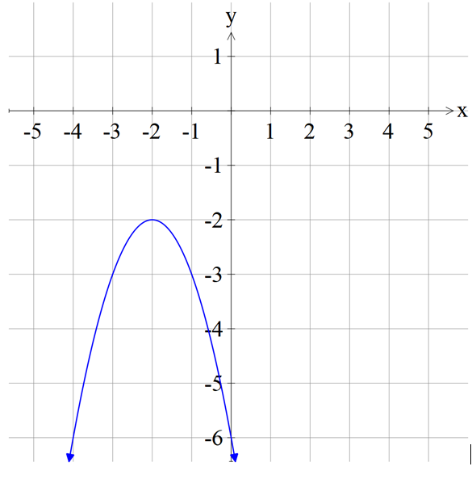

Guided Practice
Complete the square, sketch a graph and state its range. The domain is $ℝ$:
$$y={−x}^{2}−4x−6$$
Using completing the square, find the turning point:
$$y={−\left(x+2\right)}^{2}−2$$
Range $=(−∞,−2]$

Slide 11
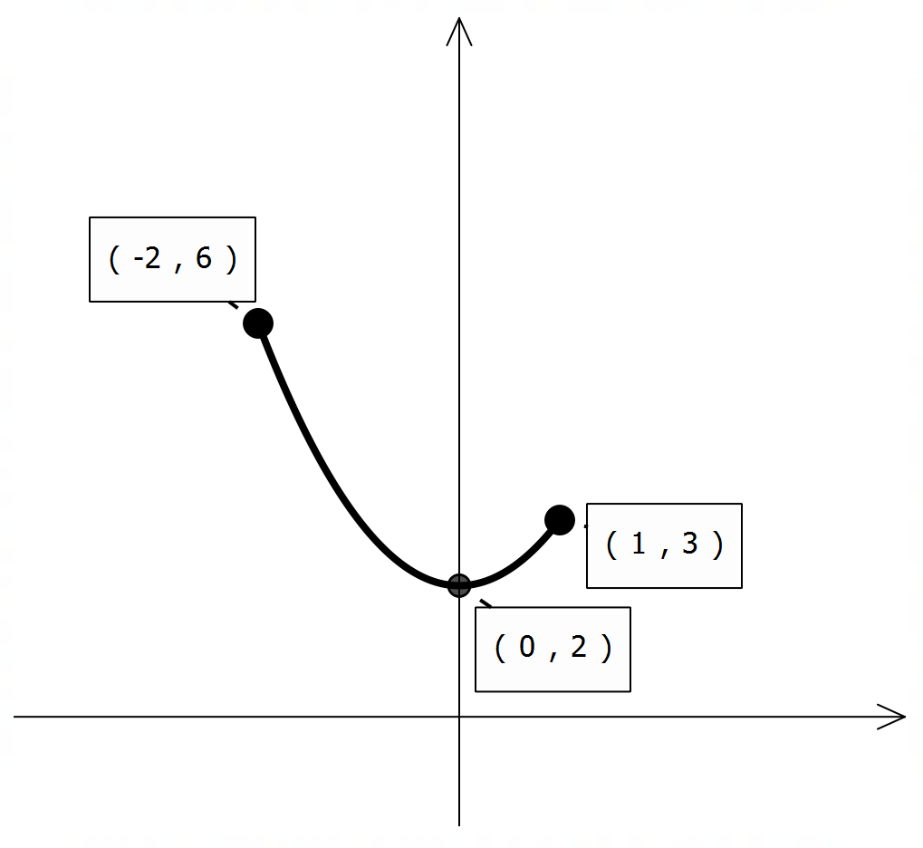


Guided Practice
Sketch the graph of the relation $y=x^{2}+2$ for $x∈[−2,1]$ and state the range.
Turning point: $(0,2)$
Range $=[2,6]$

Slide 12
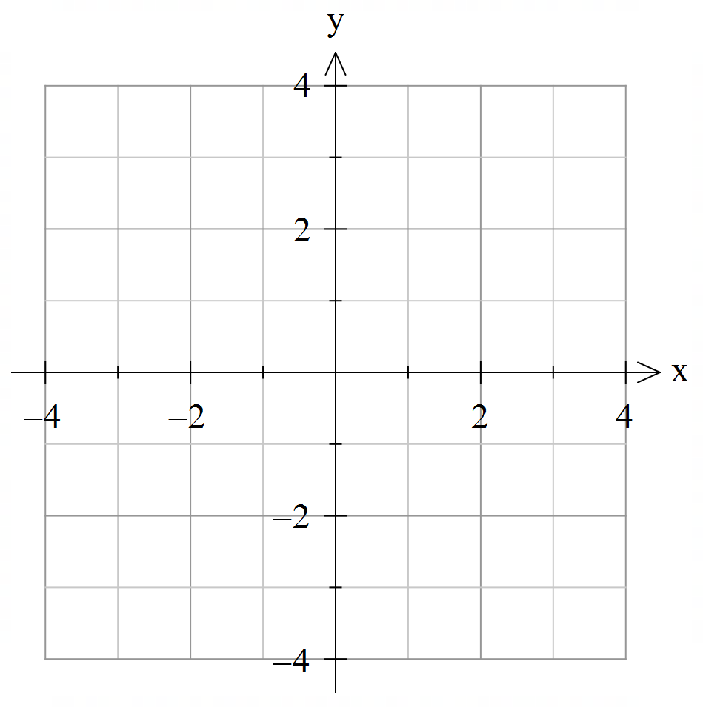



Guided Practice
Sketch a graph of each of the following relations and state its implied domain and range:
$${\left(x−1\right)}^{2}+y^{2}=9$$
Centre $=(1,0)$
Radius = 3
Domain $=\left\{x:−2≤x≤4\right\}$
Range $=\left\{y:−3≤y≤3\right\}$

Slide 13
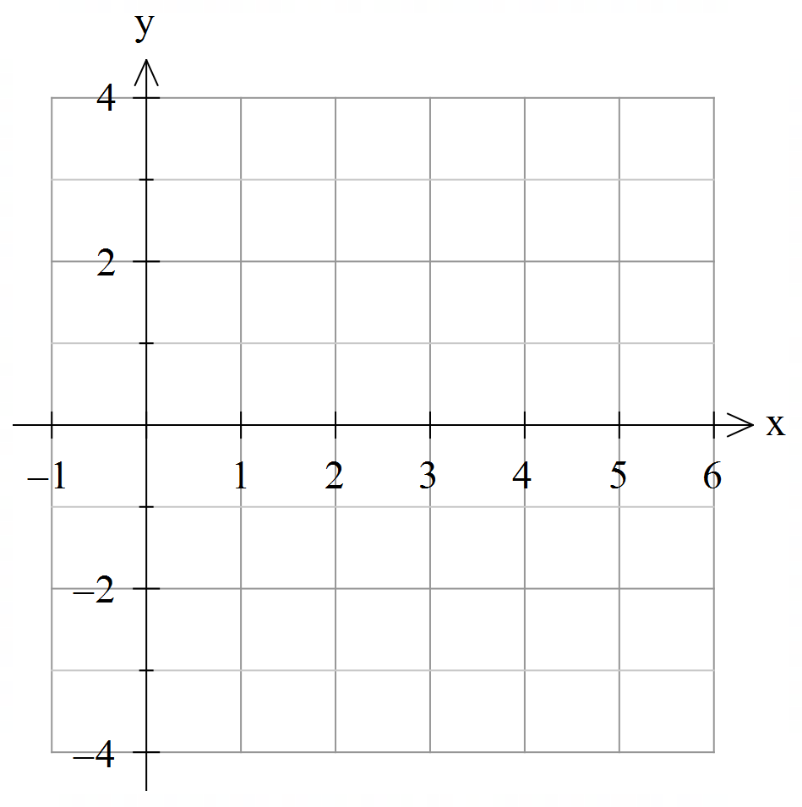
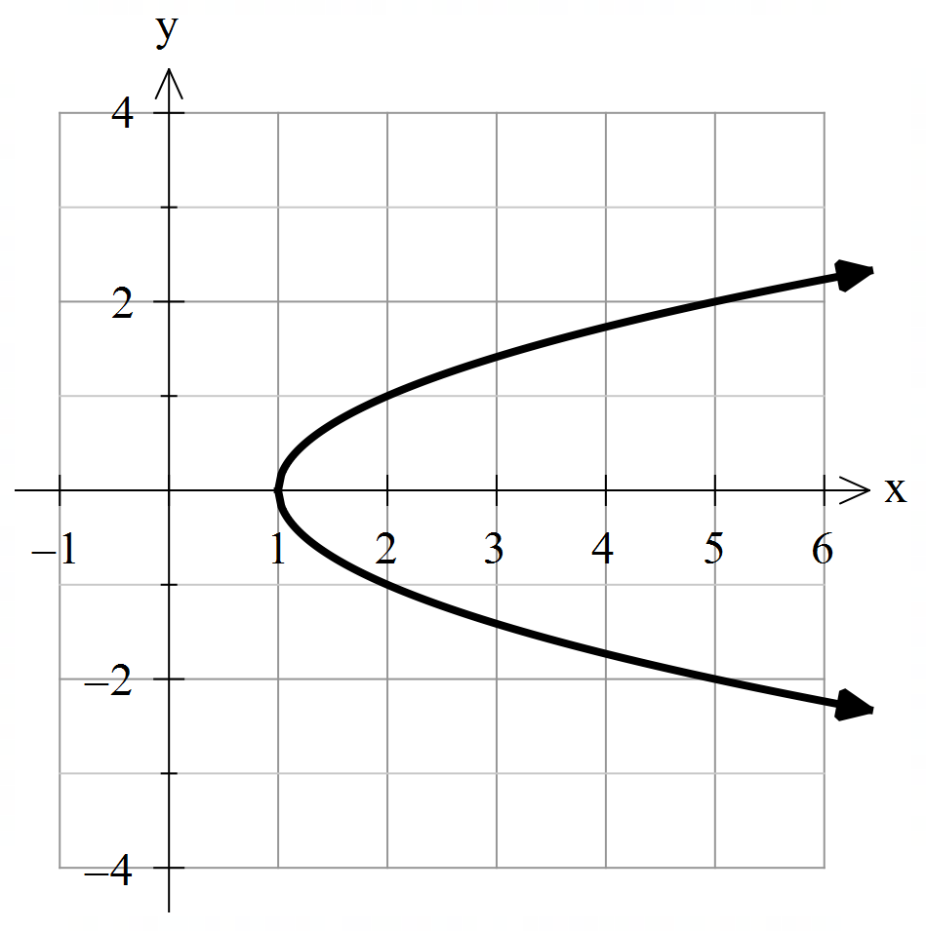



Guided Practice
Sketch a graph of each of the following relations and state its implied (maximal) domain and range:
$$y^{2}+1=x$$
$y^{2}=x−1$
Vertex $=(1,0)$
Domain: $\left\{x:x≥1\right\}$
Range: $\{y:y∈ℝ\}$

Slide 14
Independent Practice
Complete Cambridge Ex 6B

